Slide 1


Slide 2
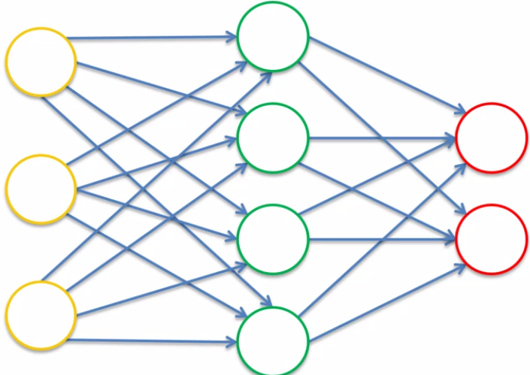

Slide 3
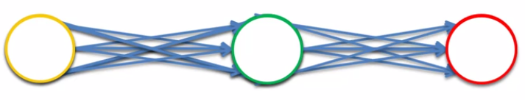

Slide 4
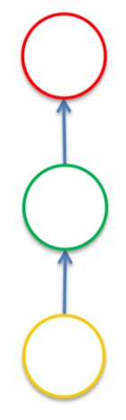
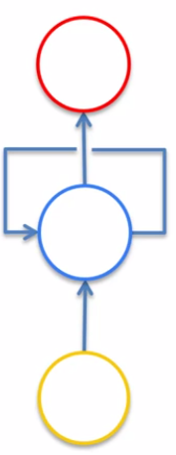

Slide 5
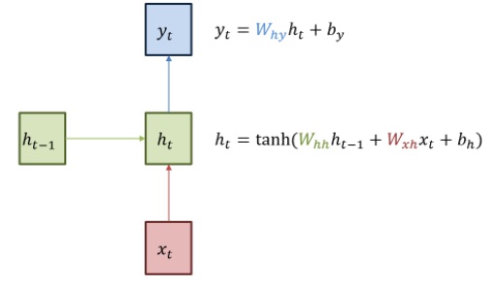

Slide 6
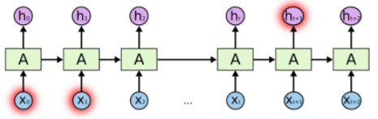

Slide 7
2012~2016 Google Stock Price
Date | Open | High | Low | Close | Volume
1/3/2012 | 325.25 | 332.83 | 324.97 | 663.59 | 7,380,500
1/4/2012 | 331.27 | 333.87 | 329.08 | 666.45 | 5,749,400
1/5/2012 | 329.83 | 330.75 | 326.89 | 657.21 | 6,590,300
1/6/2012 | 328.34 | 328.77 | 323.68 | 648.24 | 5,405,900
1/9/2012 | 322.04 | 322.29 | 309.46 | 620.76 | 11,688,800
1/10/2012 | 313.7 | 315.72 | 307.3 | 621.43 | 8,824,000
1/11/2012 | 310.59 | 313.52 | 309.4 | 624.25 | 4,817,800

Slide 8
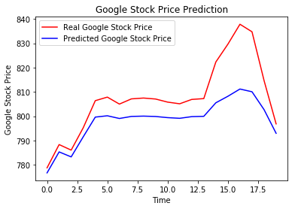

Slide 9
출처
udemy deep learning A to Z
ratsgo.github.io

